Slide 1
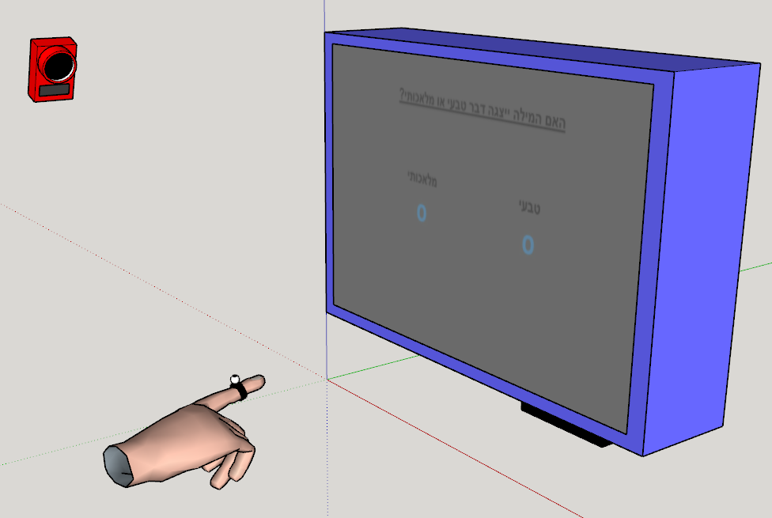
Congruent
Screen
Screen
Incongruent
Trial 1
Z index
Trial 3
Trial 2
Z index
Trial 4
Z index
Time3
same
diff
Time2
Time1
X pos
X pos
X pos
Congruent
Incongruent
Screen
Z
X

Slide 2

Correct Incorreect
Is it possible that A is closer to the screen than B?
Correct Incorreect
Screen
Screen
A B
A B
Correct Incorreect
Screen
Z index
A B
Z index
Z index
X pos
X pos
Correct Incorreect
Correct Incorreect
Screen
X pos
Screen
A B
A B
Z index
Z index
X pos
X pos

